Slide 1

Indoor Localization Robot

Slide 2
00
Introduction

Slide 3
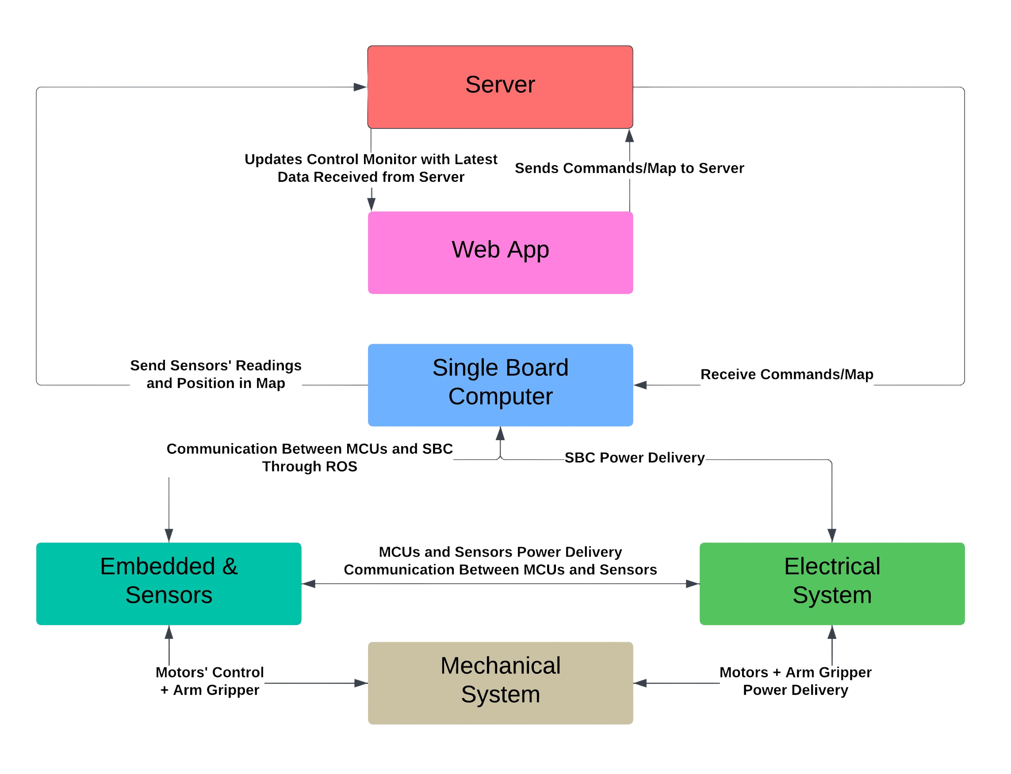
00 - Introduction

Slide 4

01
Web Application and Server

Slide 5

Why Web Application ?
Managing and controlling robotic tasks through an intuitive web interface.
0 1 - Web Application and Server

Slide 6
Structure
Seamless interaction with robot and monitor performance.
Front-end
A robust architecture, integrating databases and server-side logic to handle real-time communication.
Back-end
Server
Running the dashboard and send data reliably to the robot using ROS scripts.
0 1 - Web Application and Server

Slide 7





Technology Stack
0 1 - Web Application and Server

Slide 8
Main Features
Flexibility in Adding Robots.
Creating Maps/Paths.
Creating and assigning tasks to robots.
Control robots with real-time data visualization.
0 1 - Web Application and Server

Slide 9
02
Embedded
Sensing and Control

Slide 10
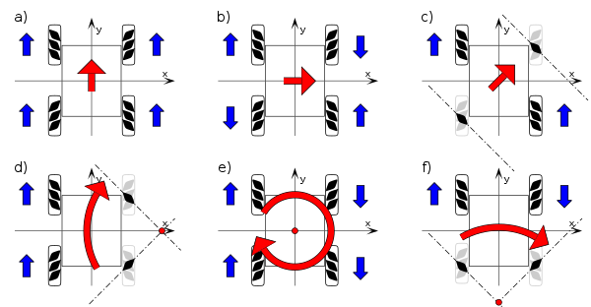
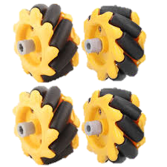
Meccanum Wheels
Enable omnidirectional movement.
0 3 - Embedded

Slide 11
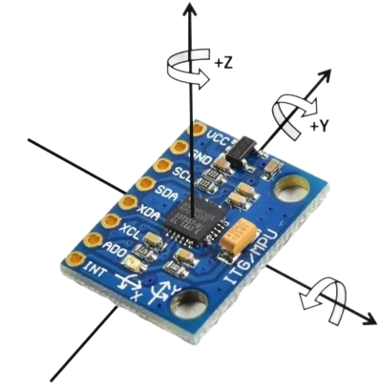
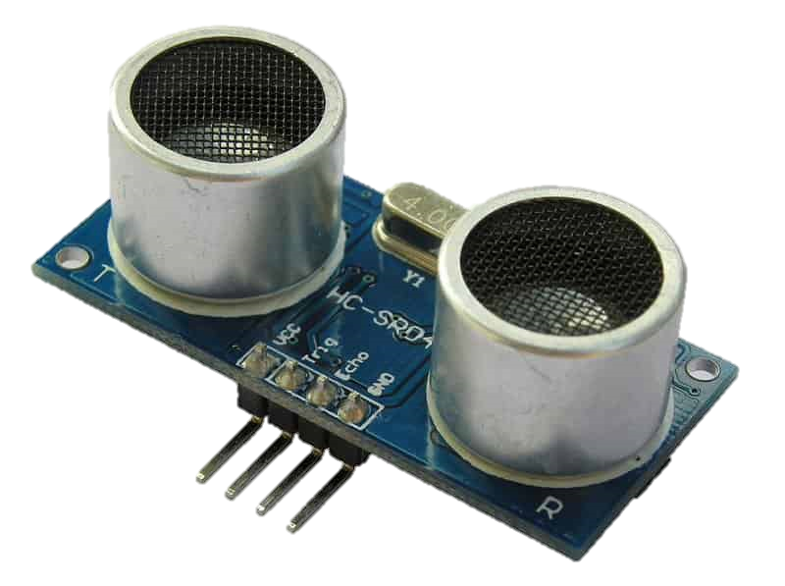
Used Sensors
IMU : MPU6050
Ultrasonic sensor
0 3 - Embedded

Slide 12
ROS Communication between Robot and Server
Sensors Board
Motors Board
0 3 - Embedded

Slide 13
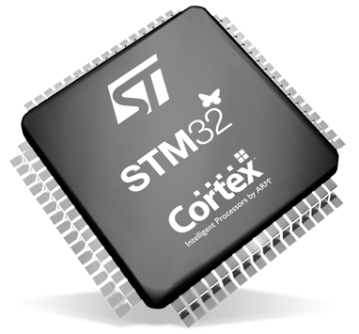
STM32 Microcontroller
Why STM32?
Key Benefit
Designed for high-performance yet low-cost applications.
Balances performance and cost for diverse device integration.
0 3 - Embedded

Slide 14
03
Hardware

Slide 15
Guiding principles
Vision
Mission
To be able to provide a solid hardware infrastructure with relative ease.
In the end of the project, the infrastructure is designed to be:
Sourced locally.
Modular.
Open-Source.
0 2 - Hardware

Slide 16
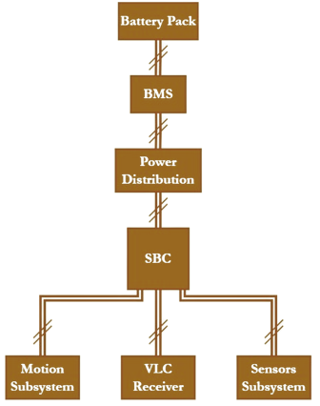
Robot Infra-structure:
0 2 - Hardware

Slide 17
Power Board:
Multiple Outputs for Power Distribution.
5V conversion, for powering the used SBC.
Reverse Polarity and Overcurrent Protection.
0 2 - Hardware

Slide 18
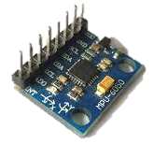
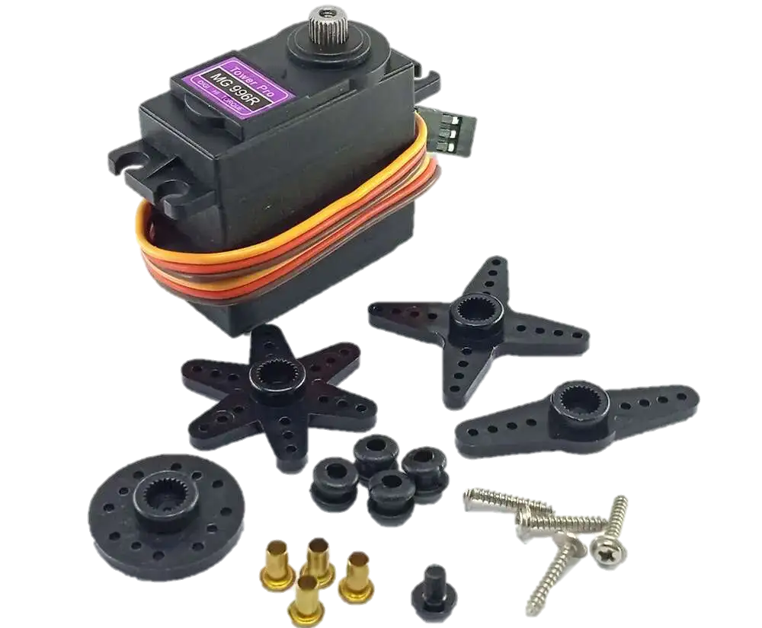
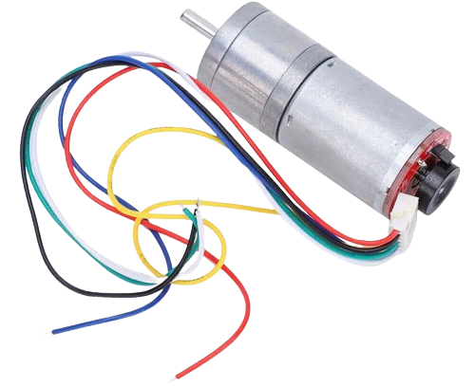
Auxiliary Boards:
Sensors Board.
Motion Board.
Actuators’ Board.
0 2 - Hardware

Slide 19
Battery Management System
Protection Features:
Monitoring Features:
Overvoltage
Undervoltage
Overcurrent
Short Circuit.
Voltage of each module.
Total Current of the pack
Temperature.
0 2 - Hardware

Slide 20
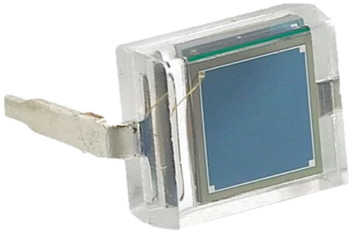
Visible Light Communication [VLC]
Transmitter
Receiver
A code is assigned to each region.
Controlled by a 220VAC LED
Each Bit maps to a certain received intensity.
Transimpedance Amplifier.
Voltage Amplifier.
Decision making.
BPW34 Micro solar cell
0 2 - Hardware

Slide 21
Thank You

